Slide 1
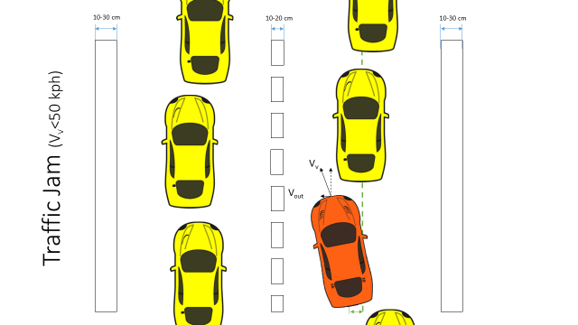
LKA Functional Safety Draft Presentation
Davide Occello, January 6th 2017

Slide 2

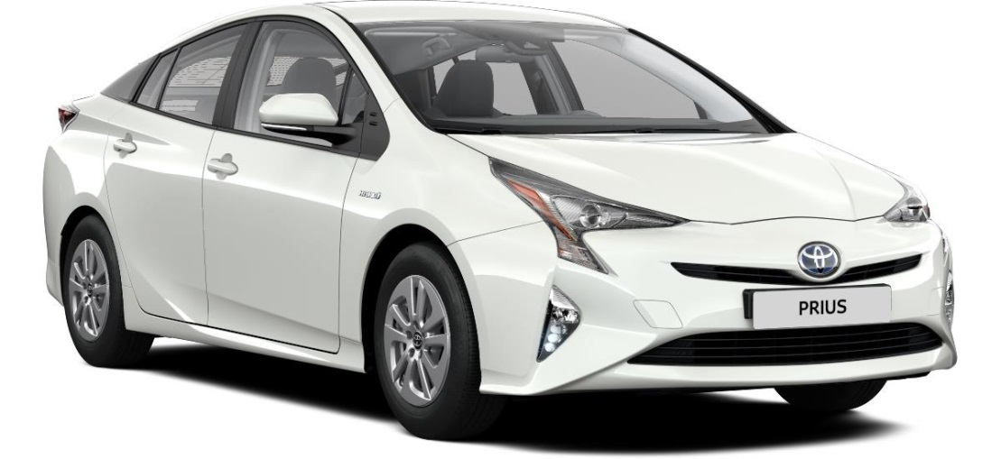
Content
Project Timeline
Euro NCAP Requirements
Functional Safety Concept (ISO 26262)
Item Definition
Safety Relevant Use Cases
HARA & Safety Goals
Functional Architecture
Functional Safety Requirements
Improved Architecture (Draft)
Deliverables

Slide 3
Project Timeline
Phase 1: Functional Safety
Phase 2:
Design
23 days
Phase 3: Implementation
25/11/16 – 13/01/17
26 days
12 days
43 days
55 days
2016
Nov
Dec
Jan
Feb
Mar
2017
Today
25.11.16
13.01.17
16.01.17
27.01.17
30.01.17
28.03.17
Project Kick Off
Project End

Slide 4
Project Timeline (Phase 1)
Phase 1:
Functional Safety
25/11/16 – 13/01/17
26 days
NCAP Requirements
2nd Dec
Documentation
11th Jan
CAFCR
9th Dec
HARA
14th Dec
FSR
20th Dec
2016
Nov
Today
Dec
Jan
2017
25.11.16
13.01.17
End – Phase 1
Project Kick Off

Slide 5
EURO NCAP Requirements
Examples from the document:
Important functional requirements:
LKA: LKA should detect unintentional lane change at least, when the outside of the tire closest to the outside of the lane markings crosses 0.3 m or beyond.
(source : Partially from EURO NCAP: section1 and UNECE)
LKA: LKA shall use the lateral support system to restore control of the vehicle while countering the unintentional lane change.
(source : EURO NCAP: section1)

Slide 6
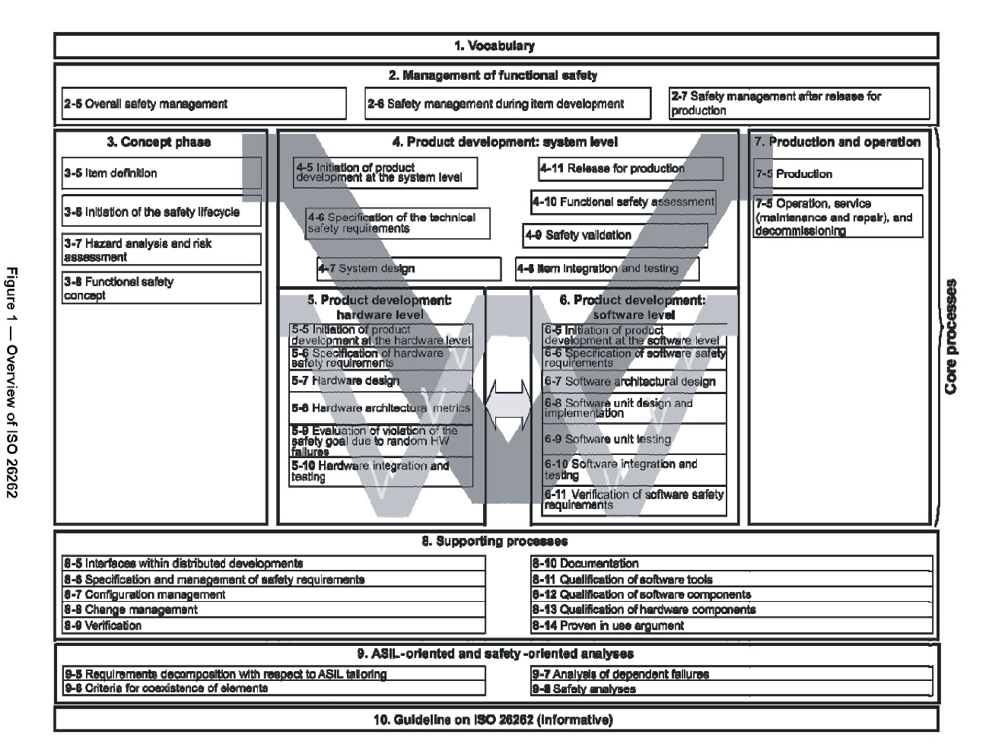
Functional Safety Concept (ISO 26262)

Slide 7
Item Definition
‘One of the causes of lane road accidents is unintended lane departure during driving. The main system function of a ‘Lane Keeping Assistance System (LKAS)’ is to detect the unintentional drift outside the lane on which it is travelling and to support the driver in keeping the vehicle within the current lane. The system primarily uses camera sensor(s) to detect lane markings or makes use of available software like mobileye to get the lane markings. It also acquires the data and estimates the lateral position of the subject vehicle and when required, sends command(s) to the actuator(s) to influence the lateral movement of the vehicle. The intention of driver to leave a lane is detected by the toggling of the indicator/turn signal switch or by even measuring the torque applied on the steering wheel of the vehicle. The status information of LKAS can be provided to the driver by means of audio, visual or even haptic elements. LKAS is an assist feature and not an autonomous driving feature. The responsibility for the safe operation of the vehicle always remains with the driver. LKAS is intended here to be operated only on highways with forward driving speed more than 50 Kph. Temperatures outside -20 to 50 deg celsius band are considered out of scope for LKAS. Roads and lane markings outside Europe are considered out of scope here.’

Slide 8
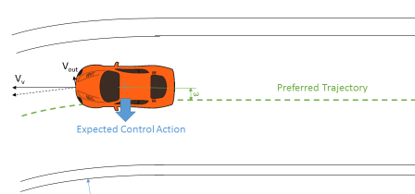



Visual Representation
Safety Relevant Use Cases
Legend:
Sunny weather/Dry road conditions
Wet weather/Wet road conditions
Engine Off

Slide 9
Highway
Vehicle Speed
V_{v}= 50 -130 kph (normal operating conditions)
V_{v}= 0 -50 kph (traffic jam)
Lane departure speeds (V_{out}) =0.1 – 1 m/s
Lateral vehicle acceleration < 0.3 g
Lane markings according to the following slides
Ideal Road Conditions:
Dry
Horizontal visibility till 1km Ambient temperature between 5 to 40 deg.
Natural ambient illumination excess of 2000 lux for day light with no strong shadow
Uniform solid paved surface with consistent slope and no irregularity within a lateral distance of 3.0 m to either side. The minimum peak braking coefficient shall be 0.9
Slope of the surface between 0 and 1 deg
Ideal Vehicle Conditions:
Original fitment of tires according to make, model, size, speed and load rating specified by the manufacturer.
Default wheel alignment measure set by the OEM
Accuracy of the sensors according to EURO NCAP

Slide 10

Straight Lane
10-30 cm
10-20 cm
3.5-3.7 m
10-30 cm
V_{v}
R >1000 m
V_{out}
Expected Control Action
ε

Slide 11
Straight Lane
10-30 cm
10-20 cm
3.5-3.7 m
10-30 cm
V_{v}
R >1000 m
V_{out}
Expected Control Action
ε

Slide 12
Curve
V_{out}
V_{v}
ε
Preferred Trajectory
Expected Control Action
R >250 m

Slide 13
Curve
V_{out}
V_{v}
ε
Preferred Trajectory
Expected Control Action
R >250 m

Slide 14


Overtaking/Lane Change
10-30 cm
10-20 cm
10-30 cm
V_{v}
V_{out}
ε

Slide 15
Overtaking/Lane Change
10-30 cm
10-20 cm
10-30 cm
V_{v}
V_{out}
ε

Slide 16
Traffic (V_{v}>50 kph)
10-30 cm
10-20 cm
10-30 cm
V_{v}
V_{out}
ε

Slide 17
Traffic Jam (V_{v}<50 kph)
10-30 cm
10-20 cm
10-30 cm
V_{v}
V_{out}
ε

Slide 18


Low visibility/Obstructed View
Bird’s Eye Perspective
Horizontal Perspective

Slide 19
Poor road condition
Bird’s Eye Perspective
Horizontal Perspective

Slide 20
Engine off (V_{v}>50 kph)
10-30 cm
10-20 cm
10-30 cm
V_{v}
V_{out}
ε

Slide 21
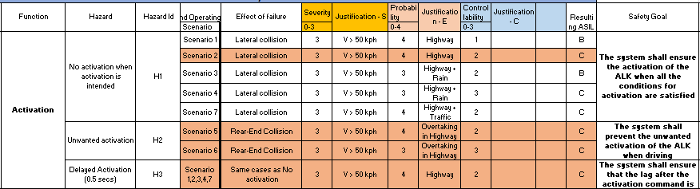
Hazard and Risk Analysis
Example for the activation function

Slide 22
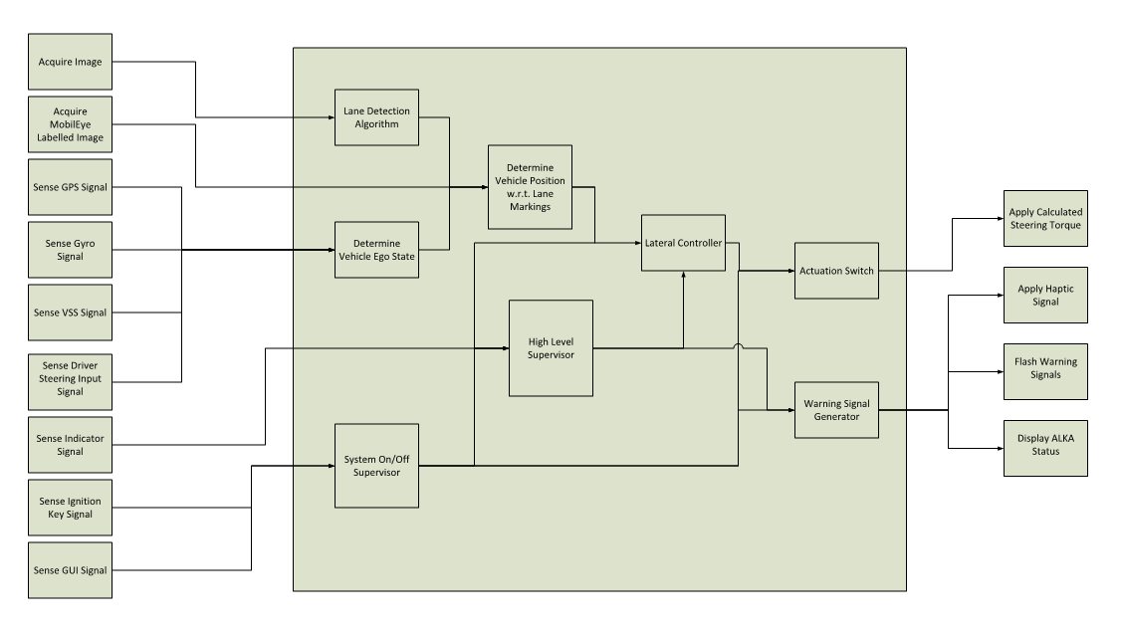
Functional Architecture

Slide 23
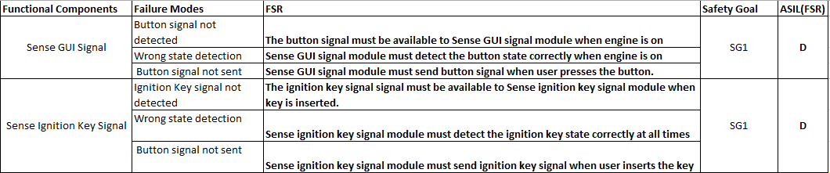
Functional Architecture

Slide 24
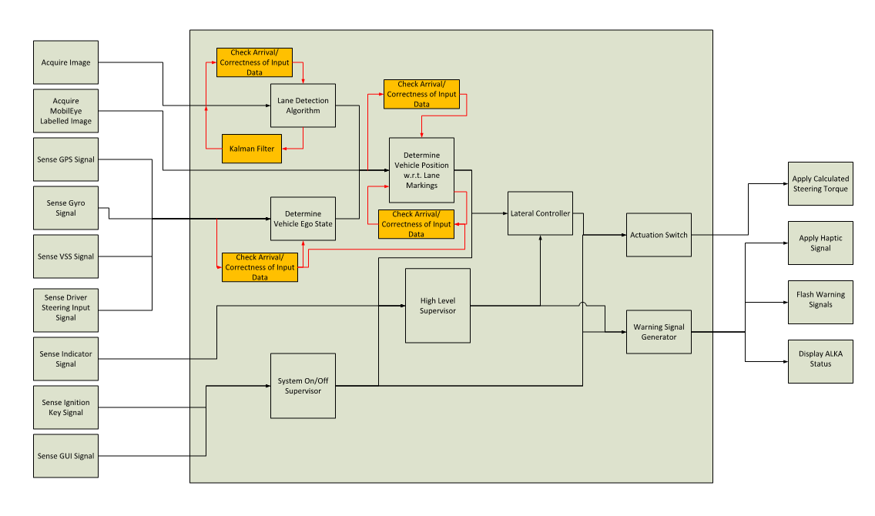
Improved Architecture (Unfinished)

Slide 25
Improved Architecture

Slide 26
Questions
?

